Slide 1

Bank Loan Case Study
Kanchan Sinha​
Excel file links

Slide 2
Project Description
Addressing the challenge of loan defaults among customers with limited credit history, this project utilizes Exploratory Data Analysis (EDA) to uncover patterns. The goal is to enhance the loan approval process, ensuring eligible applicants are not rejected while minimizing default risks.
When a customer applies for a loan, company faces two risks:
If the applicant can repay the loan but is not approved, the company loses business.
If the applicant cannot repay the loan and is approved, the company faces a financial loss.

Slide 3
When a customer applies for a loan, there are four possible outcomes:
Approved: The company has approved the loan application.
Cancelled: The customer cancelled the application during the approval process.
Refused: The company rejected the loan.
Unused Offer: The loan was approved but the customer did not use it.
As a Data Analyst my goal in this project is to use EDA to understand how customer attributes and loan attributes influence the likelihood of default.

Slide 4
Tech-Stack Used
Microsoft Excel 365
Microsoft PowerPoint
Active Presenter
Excel is a powerful spreadsheet software used for data organization, analysis, and visualization, facilitating efficient numerical calculations and creating dynamic charts.
PowerPoint is a presentation software that enables users to create visually engaging slideshows, making it an essential tool for conveying information, ideas, and messages in a professional and compelling manner.
Active Presenter is a video messaging platform allowing users to easily record, share, and communicate ideas through personalized video presentations, fostering efficient remote collaboration and communication.

Slide 5
Approach
Making Report
And explaining project in active presenter.
Importing and understanding the data
Perform various analysis to derive insights
Cleaning the data as per requirement
Visualizing outputs in graphs and charts.

Slide 6

File 1 : Application Data
Understanding Data
Columns
126
Rows
50000
Columns with null values
67
File 2 : Previous Application Data
Columns
37
Rows
50000
Columns with null values
15

Slide 7

Data Cleaning & Imputing Missing Values

Slide 10
Columns having more than 40% null values are dropped
OWN_CAR_AGE
EXT_SOURCE_1
APARTMENTS_AVG
BASEMENTAREA_AVG
YEARS_BEGINEXPLUATATION_AVG
YEARS_BUILD_AVG
COMMONAREA_AVG
ELEVATORS_AVG
ELEVATORS_AVG
FLOORSMAX_AVG
FLOORSMIN_AVG
LANDAREA_AVG
LIVINGAPARTMENTS_AVG
LIVINGAREA_AVG
NONLIVINGAPARTMENTS_AVG
NONLIVINGAREA_AVG
APARTMENTS_MODE
BASEMENTAREA_MODE
YEARS_BEGINEXPLUATATION_MODE
YEARS_BUILD_MODE
COMMONAREA_MODE
ELEVATORS_MODE
ENTRANCES_MODE
FLOORSMAX_MODE
FLOORSMIN_MODE
LANDAREA_MODE
LIVINGAPARTMENTS_MODE

Slide 11
Columns having more than 40% null values are dropped
LIVINGAREA_MODE
NONLIVINGAPARTMENTS_MODE
NONLIVINGAREA_MODE
APARTMENTS_MEDI
BASEMENTAREA_MEDI
YEARS_BEGINEXPLUATATION_MEDI
YEARS_BUILD_MEDI
COMMONAREA_MEDI
ELEVATORS_MEDI
ENTRANCES_MEDI
FLOORSMAX_MEDI
FLOORSMIN_MEDI
LANDAREA_MEDI
LIVINGAPARTMENTS_MEDI
LIVINGAREA_MEDI
NONLIVINGAPARTMENTS_MEDI
NONLIVINGAREA_MEDI
FONDKAPREMONT_MODE
HOUSETYPE_MODE
TOTALAREA_MODE
WALLSMATERIAL_MODE
EMERGENCYSTATE_MODE

Slide 12
Imputing Missing Values
Categorial column’s null values are filled with Mode
NAME_TYPE_SUITE
OCCUPATION_TYPE null value is filled by ‘Unknown’.
Numerical column’s null values are filled with Median.
AMT_ANNUITY, AMT_GOODS_PRICE, CNT_FAM_MEMBERS, EXT_SOURCE_2, EXT_SOURCE_3, OBS_30_CNT_SOCIAL_CIRCLE, DEF_30_CNT_SOCIAL_CIRCLE, OBS_60_CNT_SOCIAL_CIRCLE, DEF_60_CNT_SOCIAL_CIRCLE AMT_REQ_CREDIT_BUREAU_HOUR, AMT_REQ_CREDIT_BUREAU_DAY, AMT_REQ_CREDIT_BUREAU_WEEK, AMT_REQ_CREDIT_BUREAU_MON AMT_REQ_CREDIT_BUREAU_QRT, AMT_REQ_CREDIT_BUREAU_YEAR

Slide 13
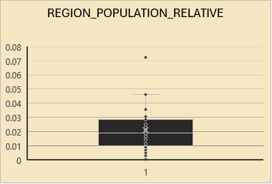
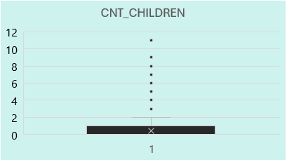
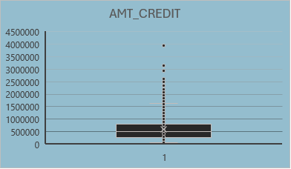
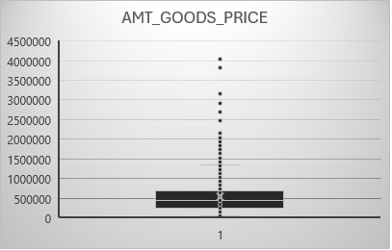
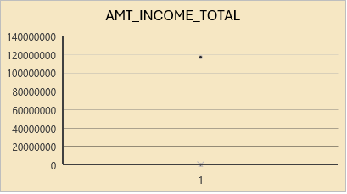
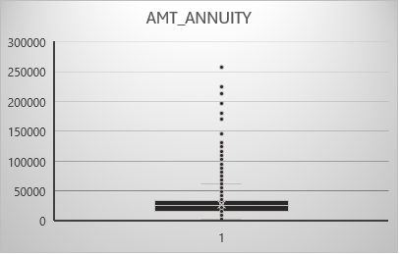
Outliers Detection

Slide 14
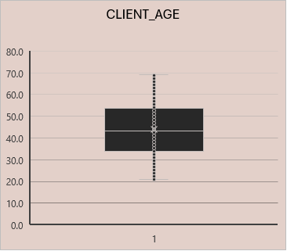
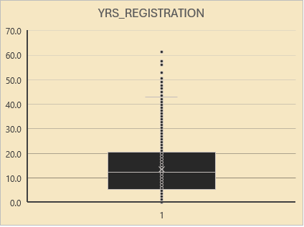
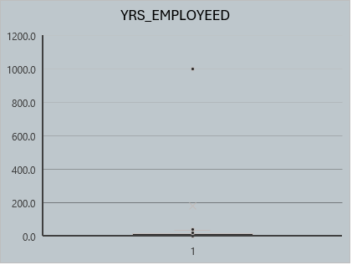
Outliers Detection

Slide 15
DATA IMBALANCE
The dataset is highly imbalanced, with a significant majority of instances belonging to class 0 (Non-Defaulter-91%) and a minority belonging to class 1 (Defaulter-9%).
Challenges: Predicting class 1 accurately may be difficult due to its minority representation.
Bank loan case study

Slide 16
Univariate, Segmented Univariate Analysis

Slide 24

Demographic Factors

Slide 25
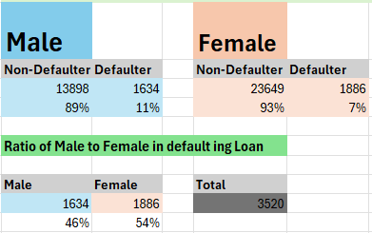
Gender Ratio in Defaults

Slide 26
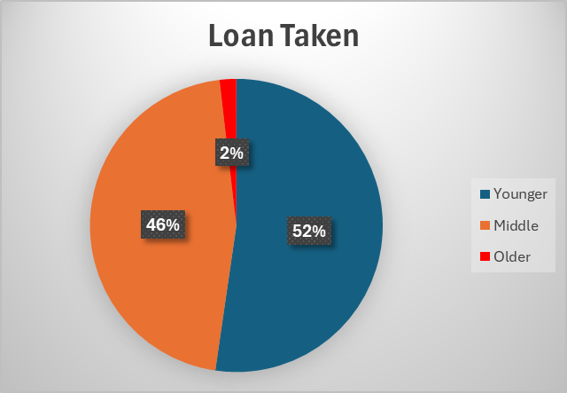


Age Factor
Most loan takers are aged 20-40, decreasing in older age groups.
Consider age as a factor in assessing loan default risk, with younger individuals potentially requiring closer scrutiny.
Company might consider tailoring its loan terms or interest rates based on age groups to manage default risks effectively.

Slide 27
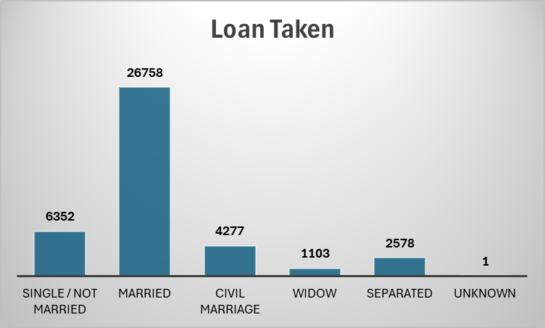
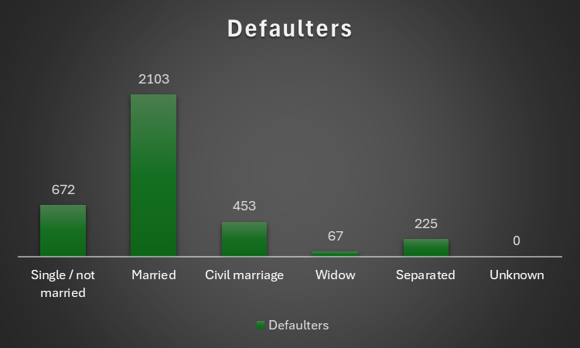
Family Status
Married individuals have the highest number of loan takers.
Single individuals (not married) show a relatively lower default rate.
Widows and separated individuals exhibit lower default numbers, suggesting potentially more stable financial situations.

Slide 28
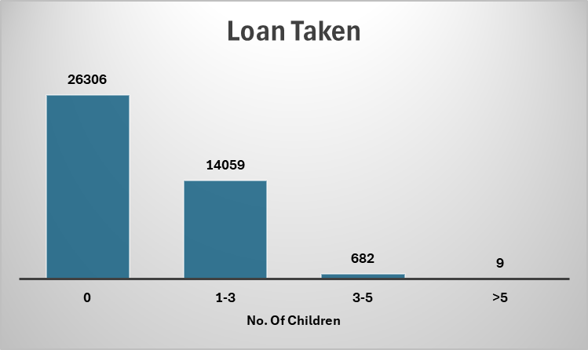
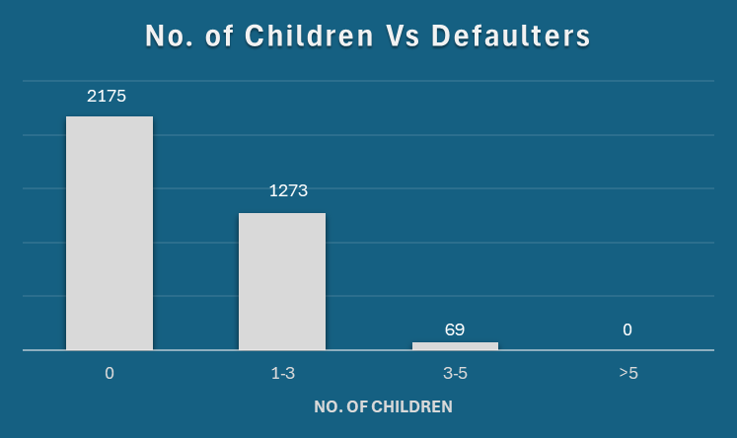
No. Of Children
Larger families (>5 children) may exhibit a lower default risk, suggesting that the financial dynamics of these households might be more stable or that these individuals manage their finances effectively.
Smaller families (0-3 children) and those with 3-5 children, on the other hand, show slightly higher default rates, indicating potentially increased financial challenges or factors influencing loan repayment.
Lenders may consider the number of children as a factor in assessing loan default risk, recognizing potential financial challenges associated with larger families.

Slide 29
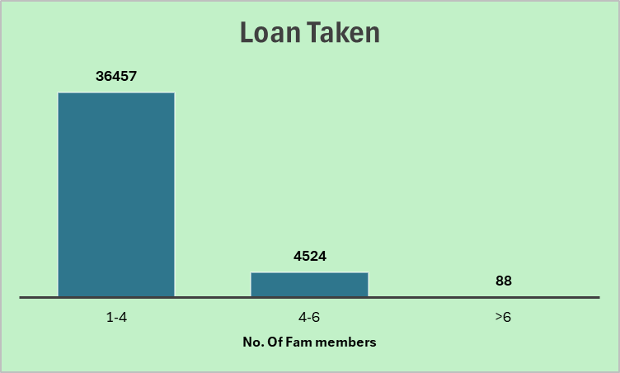
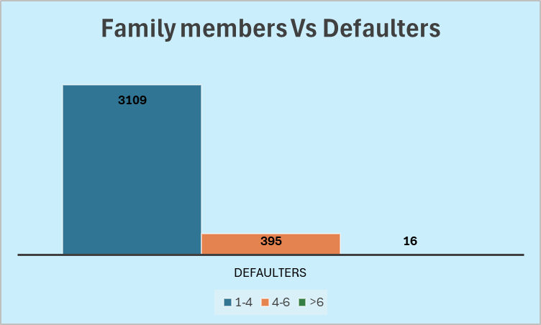
No. of Family Members
Families with 1-4 members and 4-6 members have similar default rates of 9%.
Larger families (>6 members) exhibit a higher default rate at 18%.
The data suggests a correlation between family size and default rates, with larger families facing a relatively higher risk of loan default.

Slide 30
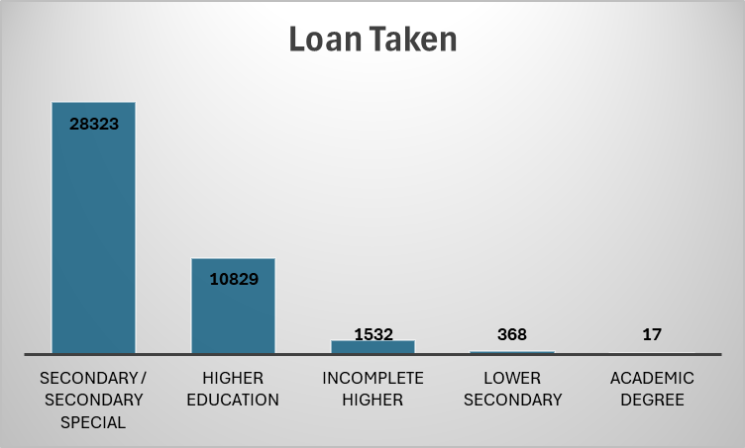
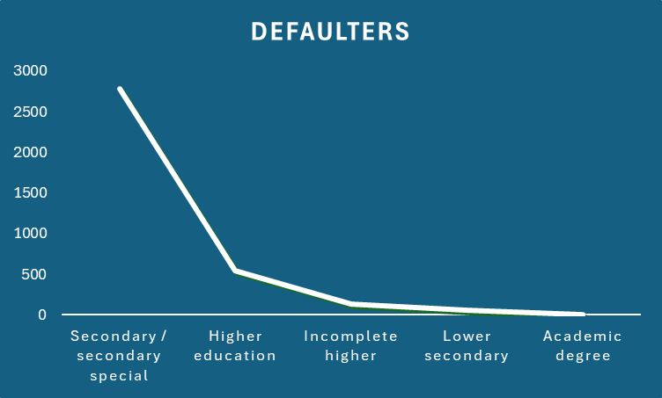
Education
Borrowers with an "Academic degree" show a 0% default rate.
"Higher education" and "Incomplete higher" categories have relatively low default rates, at 5% and 9%, respectively.
Borrowers with "Secondary / secondary special" education have a higher default rate at 10%.
These insights suggest that education level could be a useful indicator in understanding and managing loan default risks effectively.

Slide 31
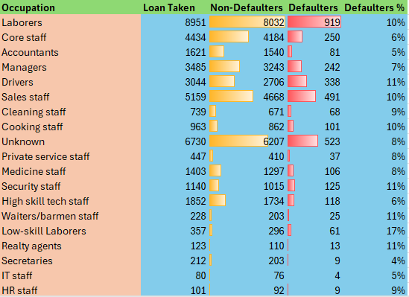
Occupation
Some occupations like Drivers, Low-skill Laborers, Security Staff, Waiters etc. may present higher default risks, potentially related to income stability, job security, or other occupational factors.

Slide 32
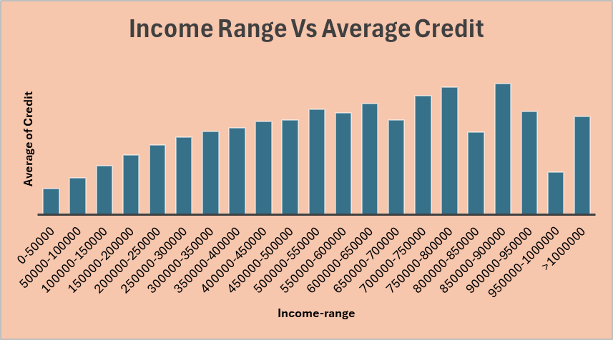
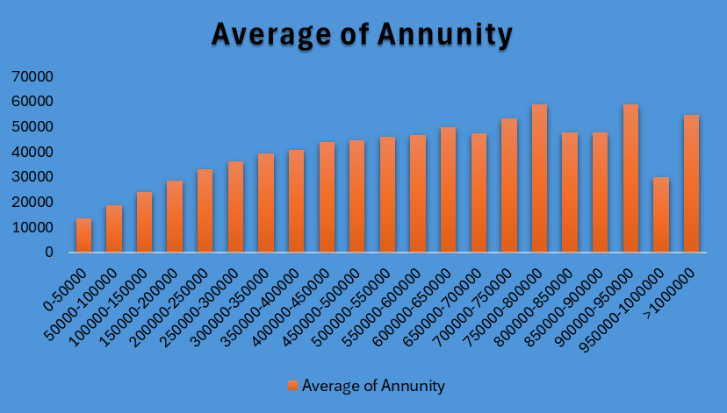
Bivariate Analysis

Slide 33
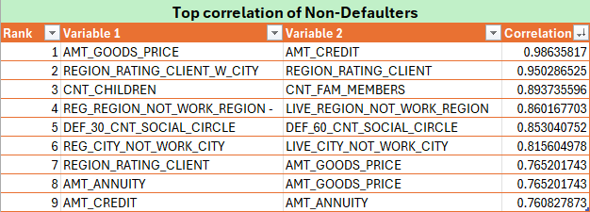
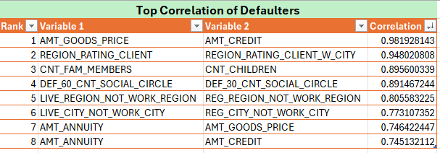
Top Correlations for Different Scenarios

Slide 34
Previous Application Data – Univariate, Segmented Univariate Analysis

Slide 35
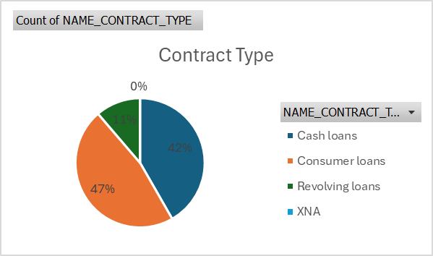
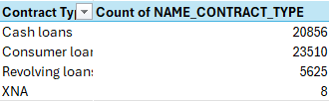
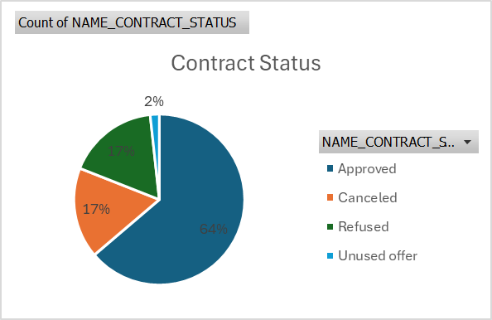

Contract Type
Contract Status

Slide 36
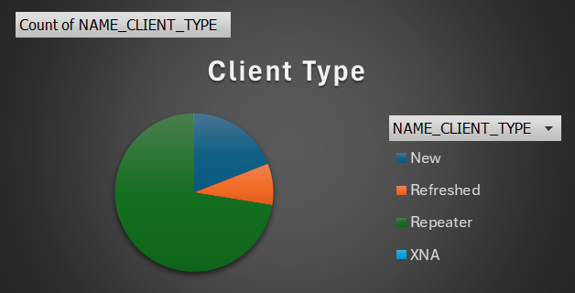
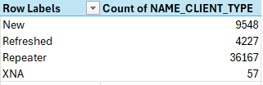
Client Type

Slide 37
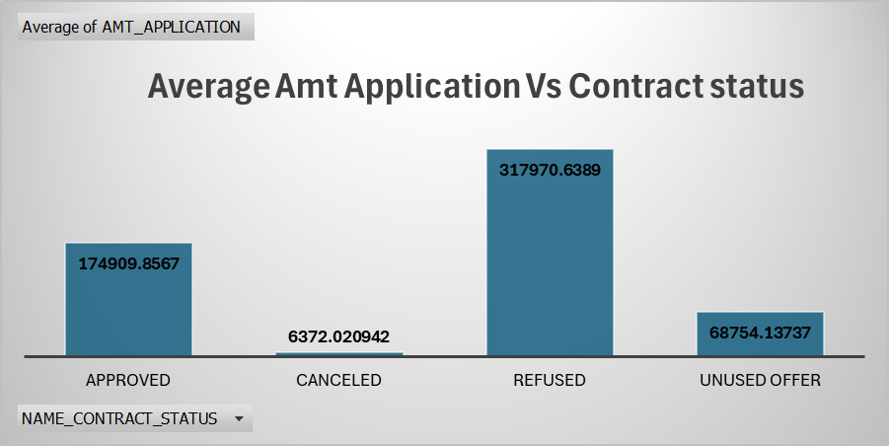
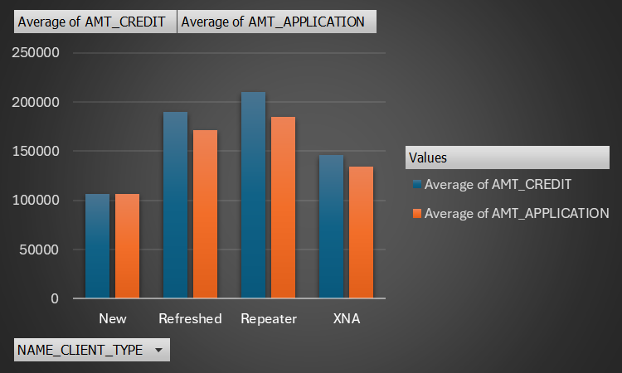

Slide 38
Result
In this case study, I applied the EDA to analyze patterns in the data.
Before starting the project, I conduct a brief research on risk analytics in banking and financial services.
I comprehend how data is employed to reduce the risk of financial losses when extending loans to customers.
This case study has assisted me in acquiring the skill of summarizing extensive datasets to extract valuable insights.
I gained knowledge about data imbalance, outliers, and the underlying factors influencing the datasets.

Slide 39

Thank you

